Slide 1
Testing with kernels
Xulun Huang

Slide 2
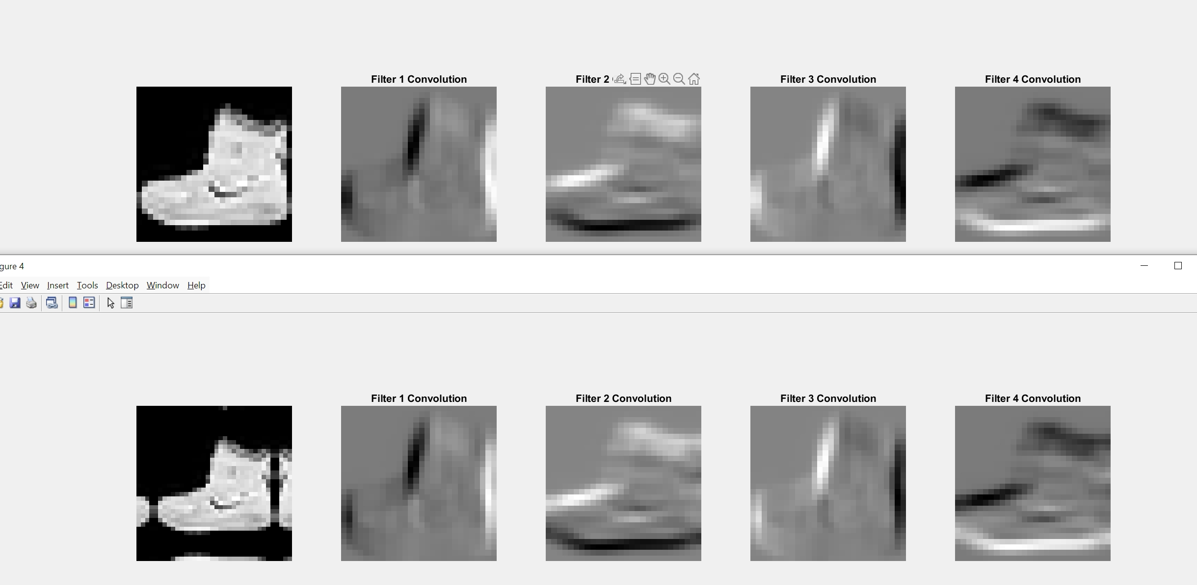
Different boundary treatment: fill vs symm
Filter size=9x9
D=10

Slide 3
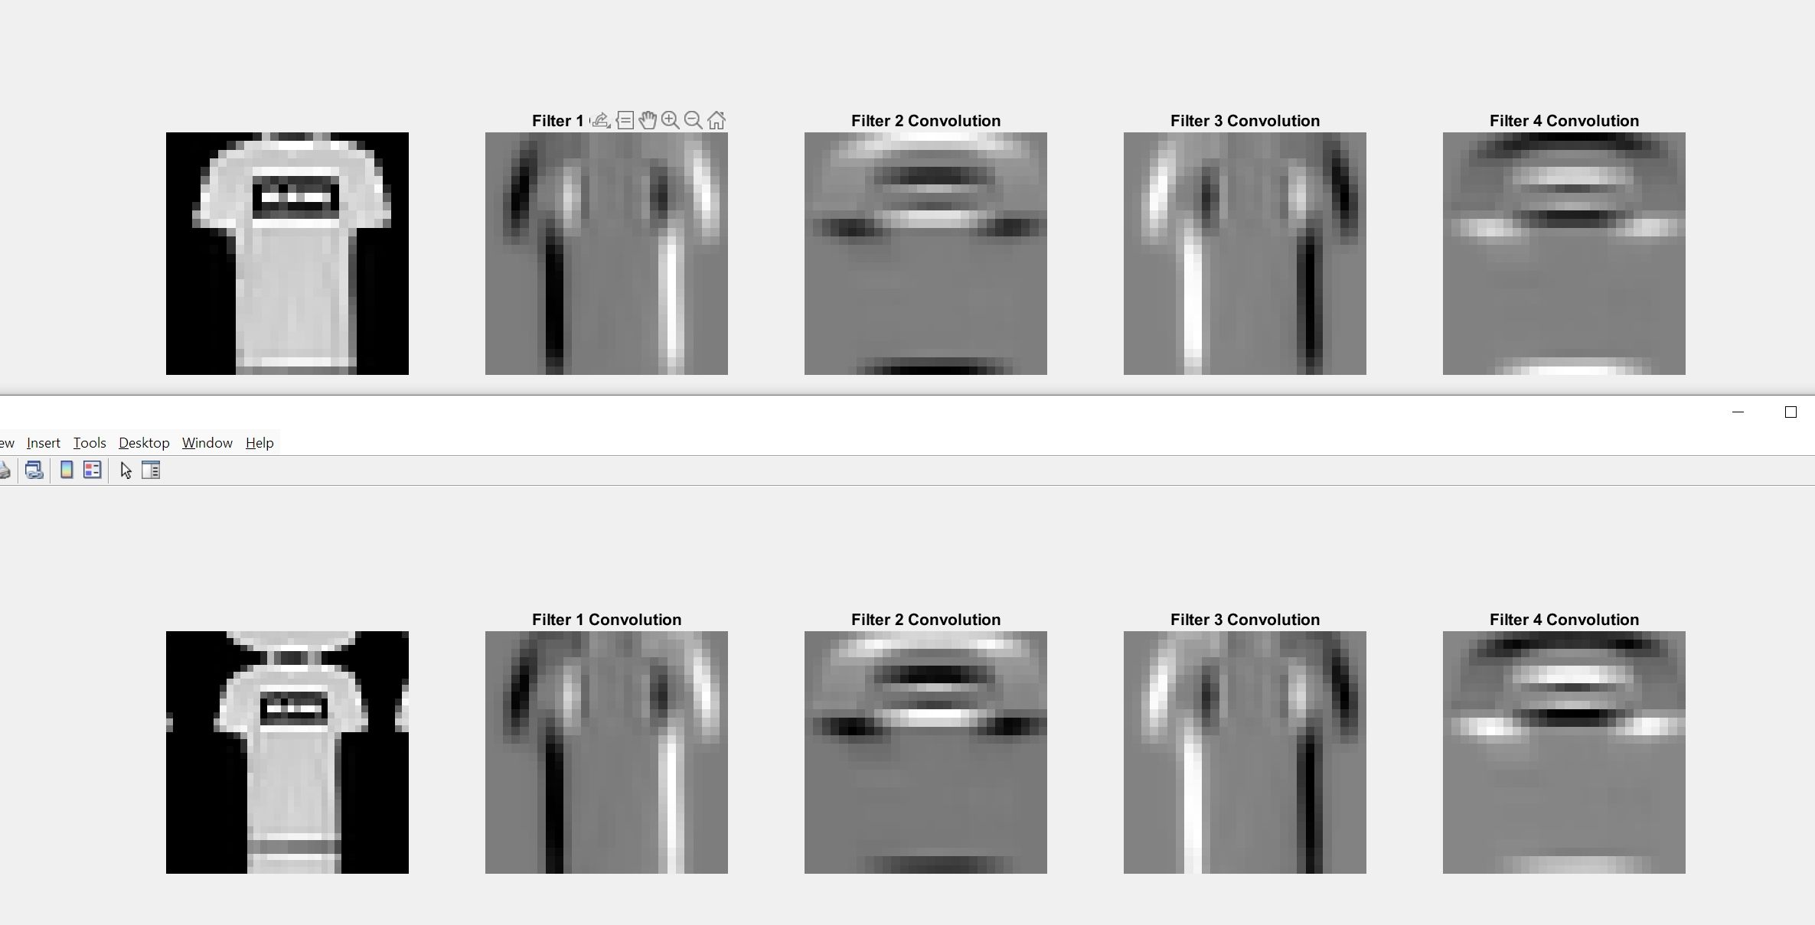

Slide 4
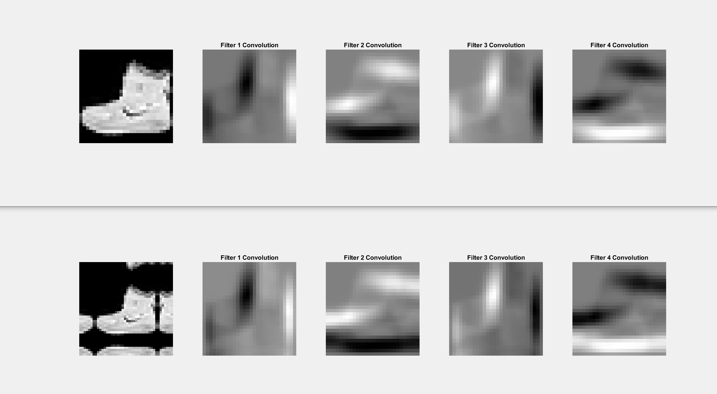
Filter size=15x15
D=20

Slide 5
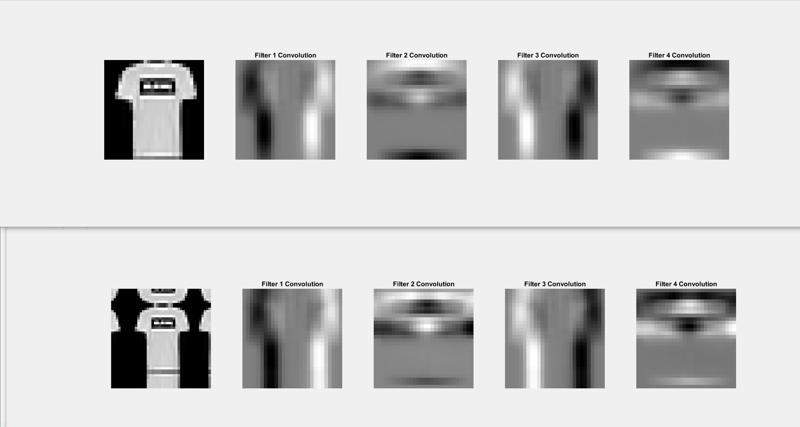

Slide 6
All trainings are based on
Adam(learning_rate=0.001), loss='categorical_crossentropy’
batch_size=128, epochs=20

Slide 7
Training results based on different boundary treatments( with filter size=9x9 and d=10 )

Slide 8
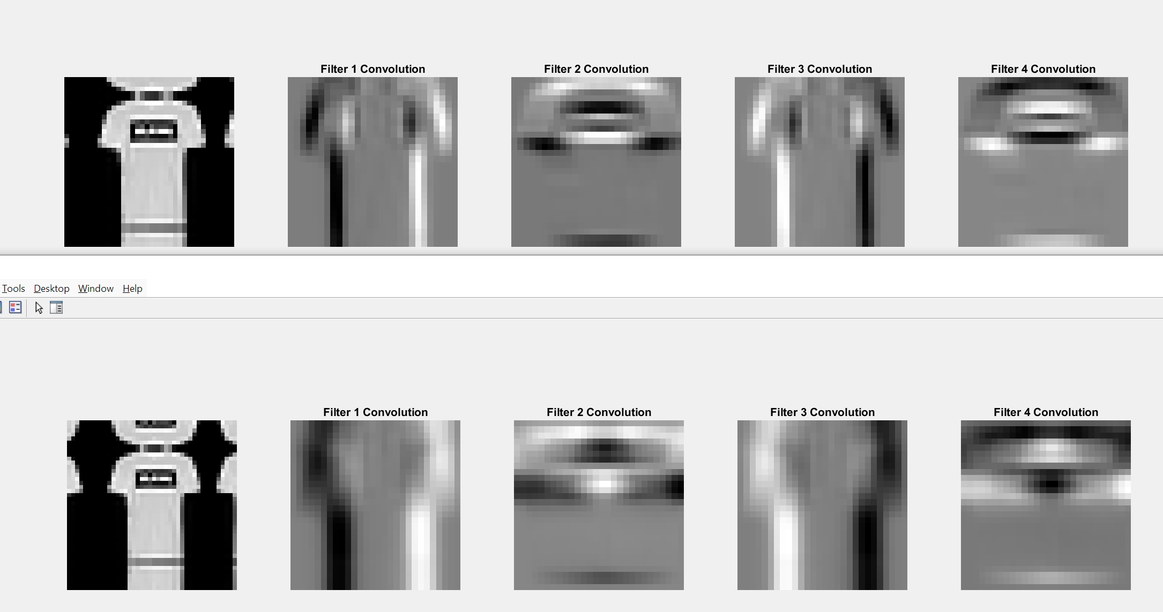
Different filter sizes d=10 vs d=20 (symm padding)

Slide 9
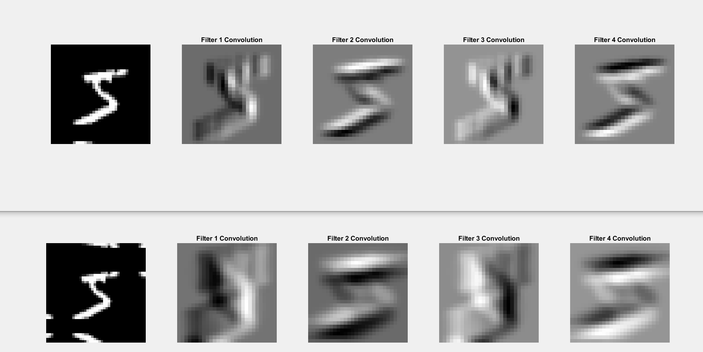

Slide 10
Training results based on different filter sizes (d=10 vs d=20)

Slide 11
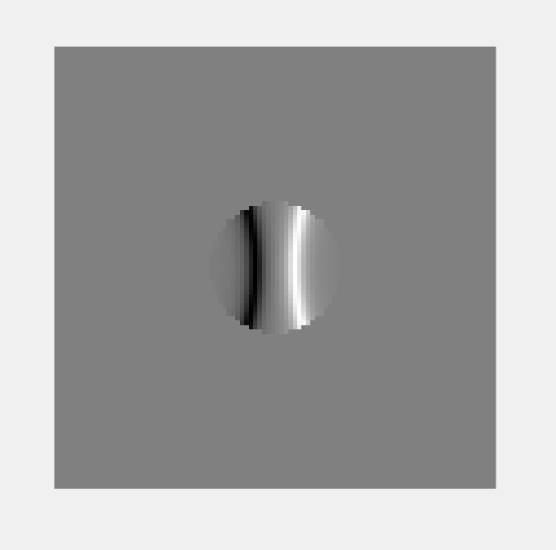
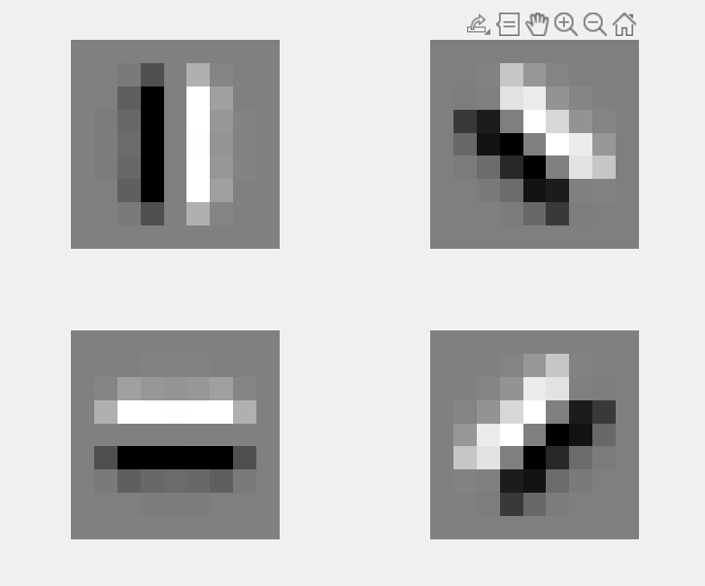
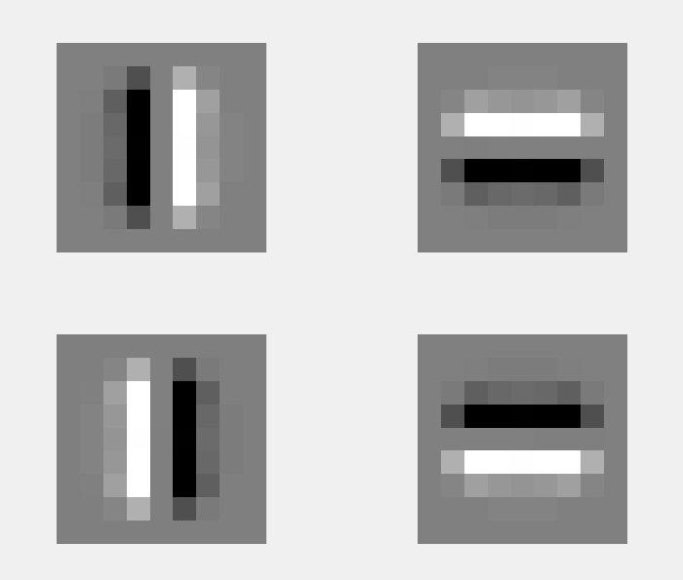
R function used:

Slide 12
Training results based on different rotations (45 vs 90 degrees per rotation of filter)

Slide 13
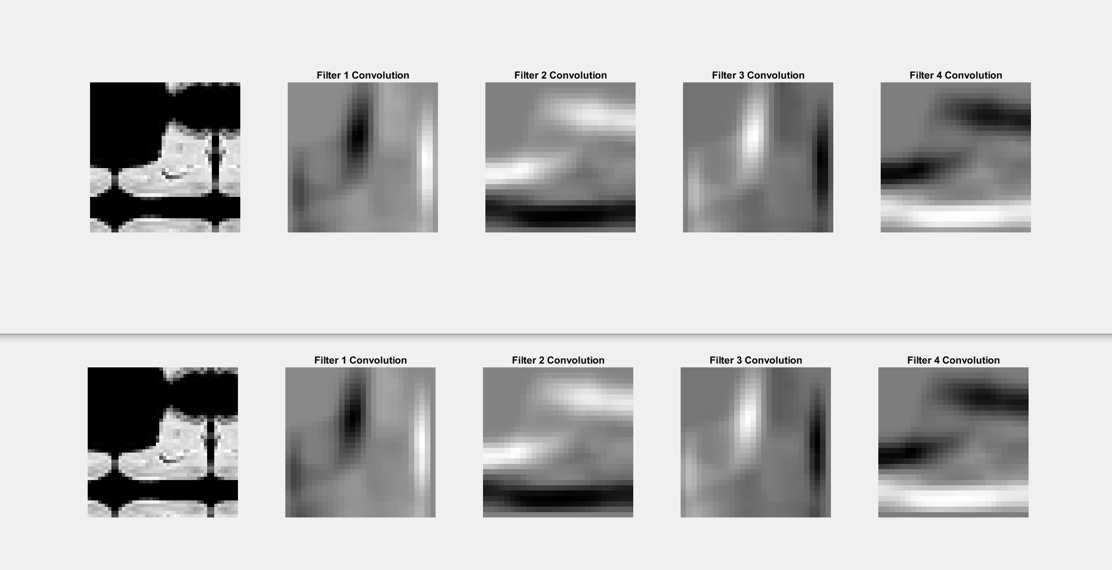
Odd size vs even size filters( 15x15 vs 16x16)

Slide 14
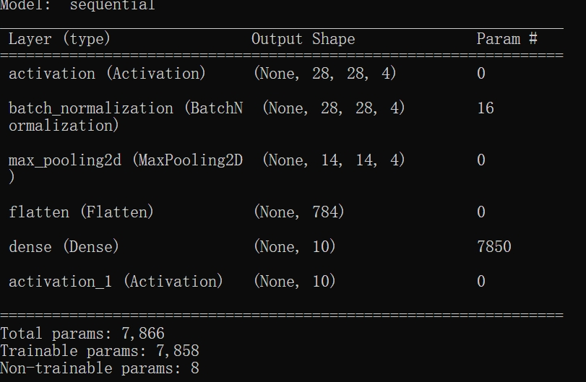

Network data
Kernel+FC for 28x28

Slide 15
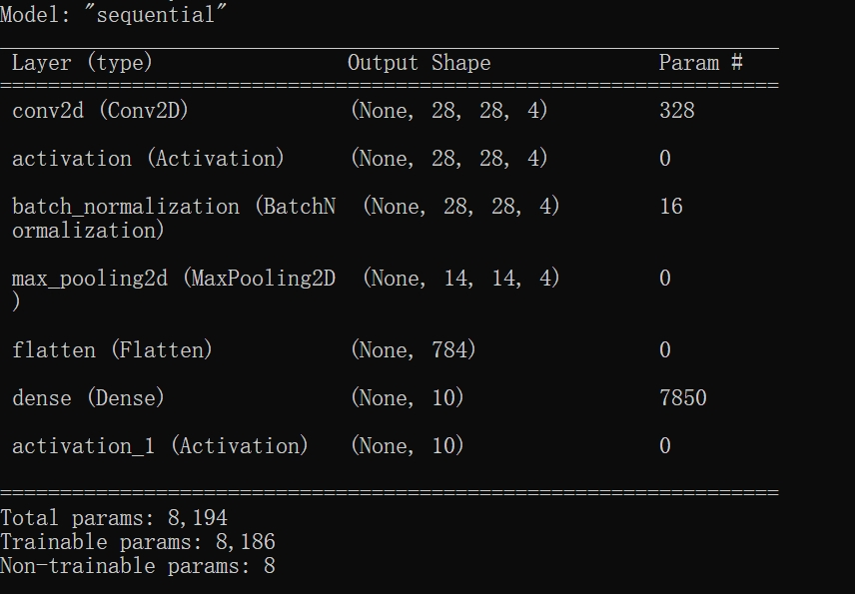

CNN+FC for 28x28

Slide 16
Stats for comparison( kernel d=10, symm boundary, 90 degree rotation)
 | Params( for 28x28 and 32x32) | Flops (for 28x28 and 32x32) | dmnist | fmnist | Cifar_gray | Cifar
CNN+FC | 8194 10594 11242 | 536340 700500 2027604 | 97.98% | 88.64% | 47.72% | 48.94%
Kernel+FC | 7866 10266 30778 | 25172(-95.3%) 32852(-95.3%) 98436(-95.1%) | 97.3% | 88.32% | 45.54% | 50.36%

